Slide 1
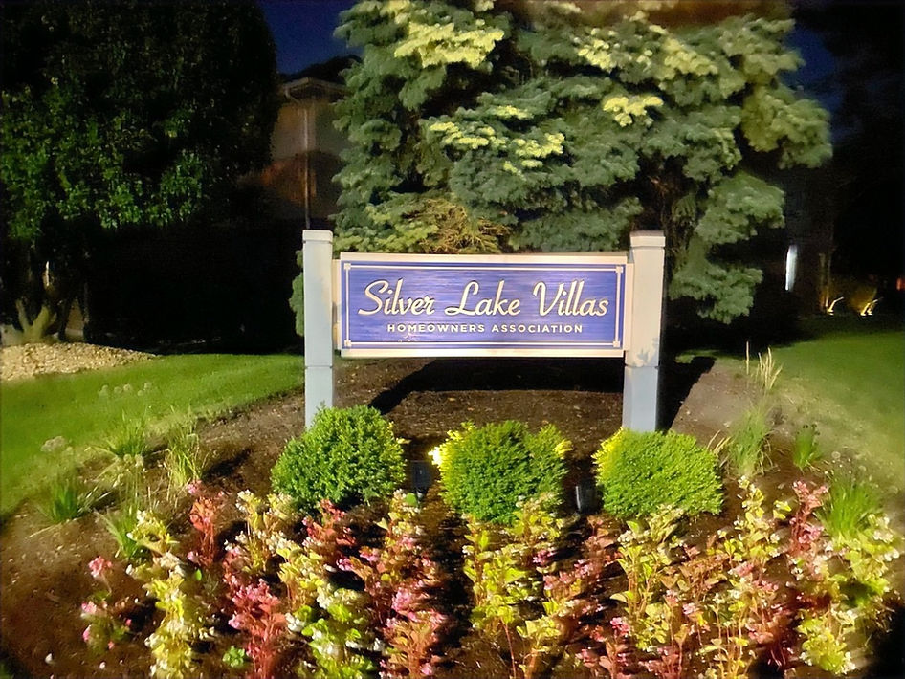
Annual Residents Meeting Silver Lakes Villas October 11, 2022 Orland Park Public Library

Slide 2
Tonight's Agenda
Meeting Called to Order: Roll Call, Presidents Remarks
CIBC Bank: Monthly Dues Direct Deposit Option
2022: Year in Review
Annual Election of Board Officers
2023 Outlook and Objectives
Questions: Open Forum

Slide 3
Monthly Assessments: Direct Deposit Option CIBC Bank
Jill Whitney-Commercial Banking
Christine Wollner-TM Sales Advisor
Barb Abhsie-Branch Manager.
Notes:
Self explanatory. Turn it over to me on the last item Curt.

Slide 4
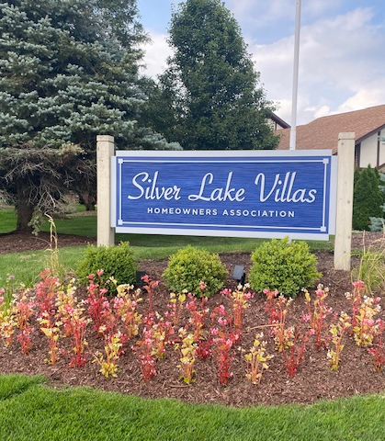
2022 Year In Review: What Have We Accomplished?

Slide 5
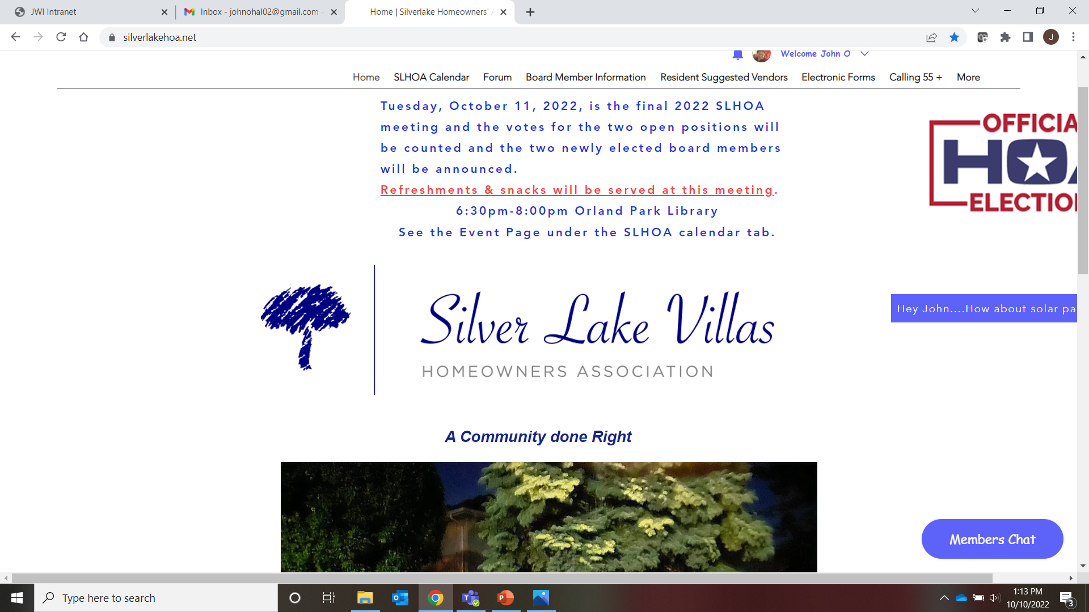
2022 Goals and Accomplishments: Better Communication
Our own Website: Silverlakes.hoa.net
Board Member Information
Meeting Minutes
Community Announcements, Services
Resident Recommended Vendor List
Electronic Work Orders.
Association By-Laws, Rules, Regulations.
Lots of Other Stuff
Quarterly Open Remote Meetings-Orland Park Public Library
Updated Logo and Branding
Better Communication Between Board and Residents

Slide 6
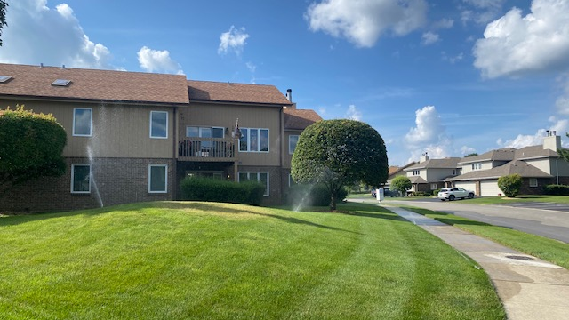
2022 Goals and Objectives “Looking Worn”
New Entrance Signage and Landscaping
Upgraded Landscape Services
Power Washed Sidewalks
Upgrades on sprinkler heads for irrigation system.
Ice Cream Social!!!!!
Notes:
Mention the dying box woods will shortly be removed and replaced by dwarf burning bushes. Building and Ground Committee.

Slide 7
2022 Goals and Objectives-Admin Updates
Building and Grounds Director Officer Position Created
Reviewed, rewrote and published on-line association by-laws.
Digitized all current and available past association documentation.
Visitor Lots Parking Restrictions Eliminated.
Additional By-Laws and Rules Clarified and Upgraded.
Upgraded software and PC’s, where required.
Updating financial practices .
Increased service fees from Relators for sales transactions.

Slide 8
Election Time
Maureen Swearingen is your Host!
Two Board Positions Are Up for Election.
Vote Away!

Slide 9
2023 Association Goals and Outlook
Roofs!
Text Alert System
Start Village Square
2023 Landscape Plan
Comprehensive Review of all Rules and By-Laws
Whatever Else is Up to You!!!
Notes:
Encourage people to go to the webpage to read the roofing report. Worried about more plant and trees dying and their removal and replacements.
Encourage clubs, getting together, gardening etc.

Slide 10
